Slide 1
Circle Revision
EQ – How do I find the area and perimeter of shapes that have parts of circles?
Year 8

Slide 2
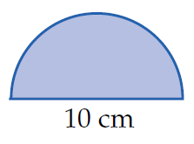
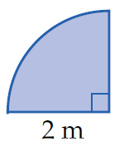
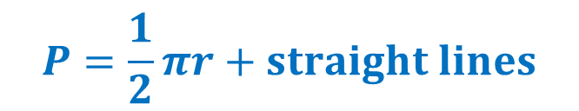


24
7
30
Circle Revision
Date
EQ – How do I solve problems involving circles?
How do I solve perimeter problems?
$$P=πr+straight line$$
$$P=\frac{1}{2}πr+straight lines$$
1 m
$$P=\frac{3}{2}πr+straight lines$$
* If you have a circle with a diameter you will need to half it in order to find the radius.
Notes:
A set of formula in case students want a consolidated set

Slide 3



24
7
30
Circle Revision
Date
EQ – How do I solve problems involving circles?
How do I solve area problems?
$$A=\frac{1}{2}πr^{2}$$
$$A=\frac{1}{4}πr^{2}$$
1 m
$$A=\frac{3}{4}πr^{2}$$
Notes:
A set of formula in case students want a consolidated set

Slide 4


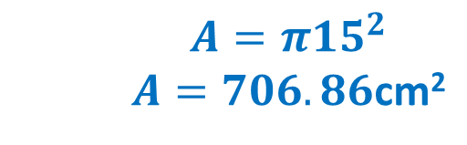
Demonstration Problem
A pizza tray has a diameter of 30cm.
Calculate its area to the nearest whole number of cm².
1. Draw a picture
30cm
2. What is the formula we need?
$$A=πr^{2}$$
3. What is the radius?
$$r=15 cm$$
4. Substitute the numbers we know into the equation and solve.
$$A=π{15}^{2}$$ $A=706.86$cm²

Slide 5
Practice
A tree trunk is cut to reveal a circular cross-section of radius 60cm. Is the area of the cross-section more than 1m² and, if so, by how much?
A circular oil slick has a diameter of 1km. The newspaper reported an area of more than 1km². Is the newspaper correct?
Which has the largest area, a circle of radius 5m, a semicircle of radius 7m, or a quadrant of radius 9m?
Two circular plates have radii 12cm and 13cm. Find the difference in their area correct to 2 decimal places.

Slide 6
Practice
A tree trunk is cut to reveal a circular cross-section of radius 60cm. Is the area of the cross-section more than 1m² and, if so, by how much? Yes, by 1310cm²
A circular oil slick has a diameter of 1km. The newspaper reported an area of more than 1km². Is the newspaper correct? No (A=0.79km²)
Which has the largest area, a circle of radius 5m, a semicircle of radius 7m, or a quadrant of radius 9m? Circle radius 5m
Two circular plates have radii 12cm and 13cm. Find the difference in their area correct to 2 decimal places. 78.54cm²

Slide 7
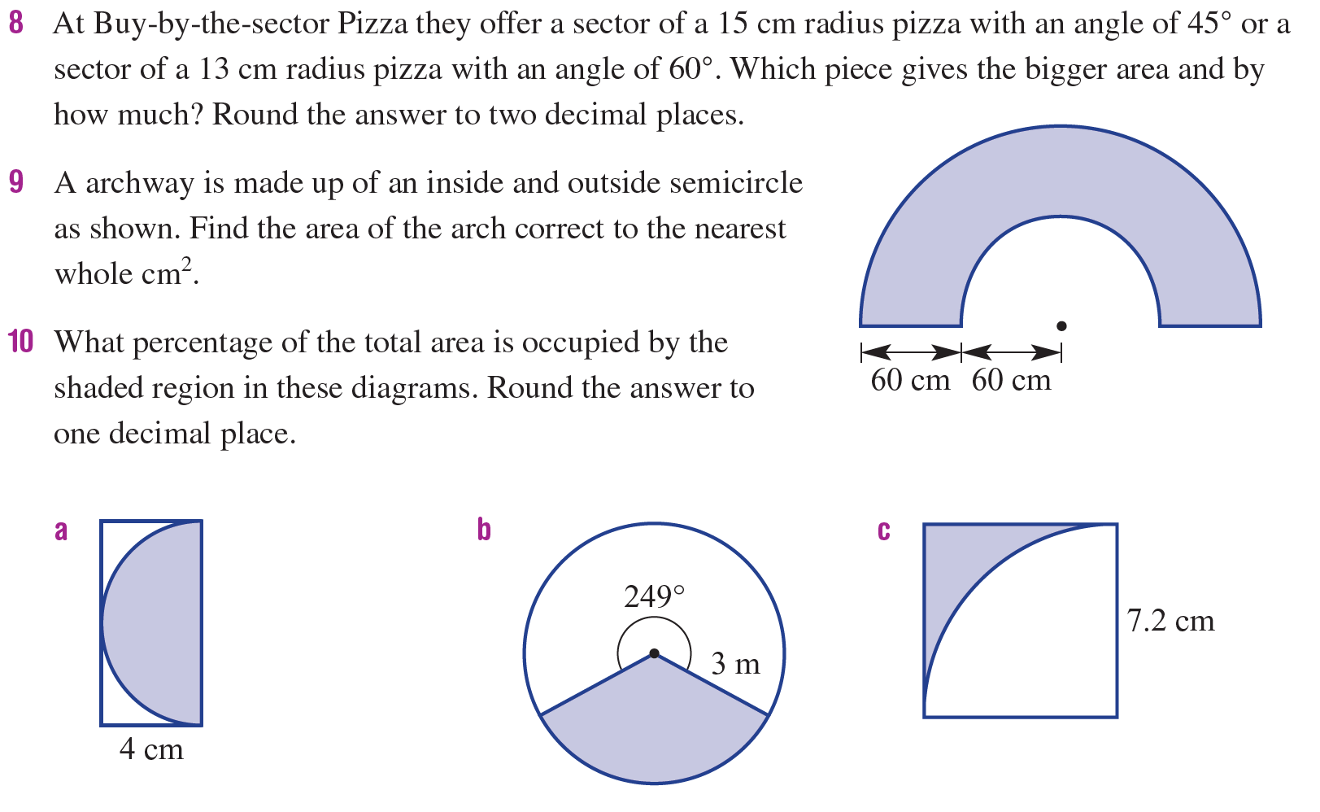
Practice

Slide 8
Practice
13 cm pizza by 0.13cm²
16 965cm²
78.5%
30.8%
21.5%

Slide 9

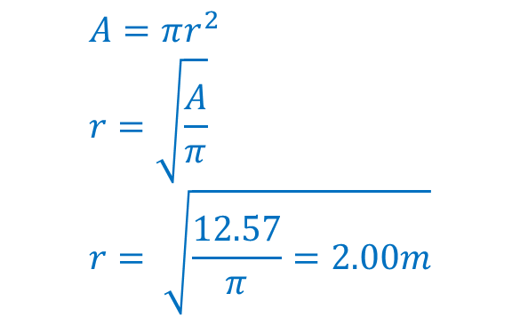
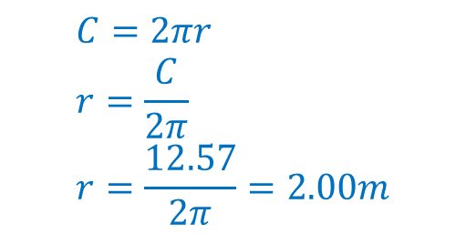

24
7
30
Circle Revision
Date
EQ – How do I solve problems involving circles?
How do I find radius from area or perimeter?
Rewrite the formula using radius as the unknown then simplify
$$A=πr^{2} \\ r=\sqrt{\frac{A}{π}} \\ r= \sqrt{\frac{12.57}{π}=2.00m}$$
A = 12.57 m², what is the radius?
(round to 1dp)
C = 25.14 m, what is the radius?
(round to 1dp)
$$C=2πr \\ r=\frac{C}{2π} \\ r=\frac{12.57}{2π}=2.00m$$
$$A=πr^{2}$$
$$C=2πr$$

